Slide 1
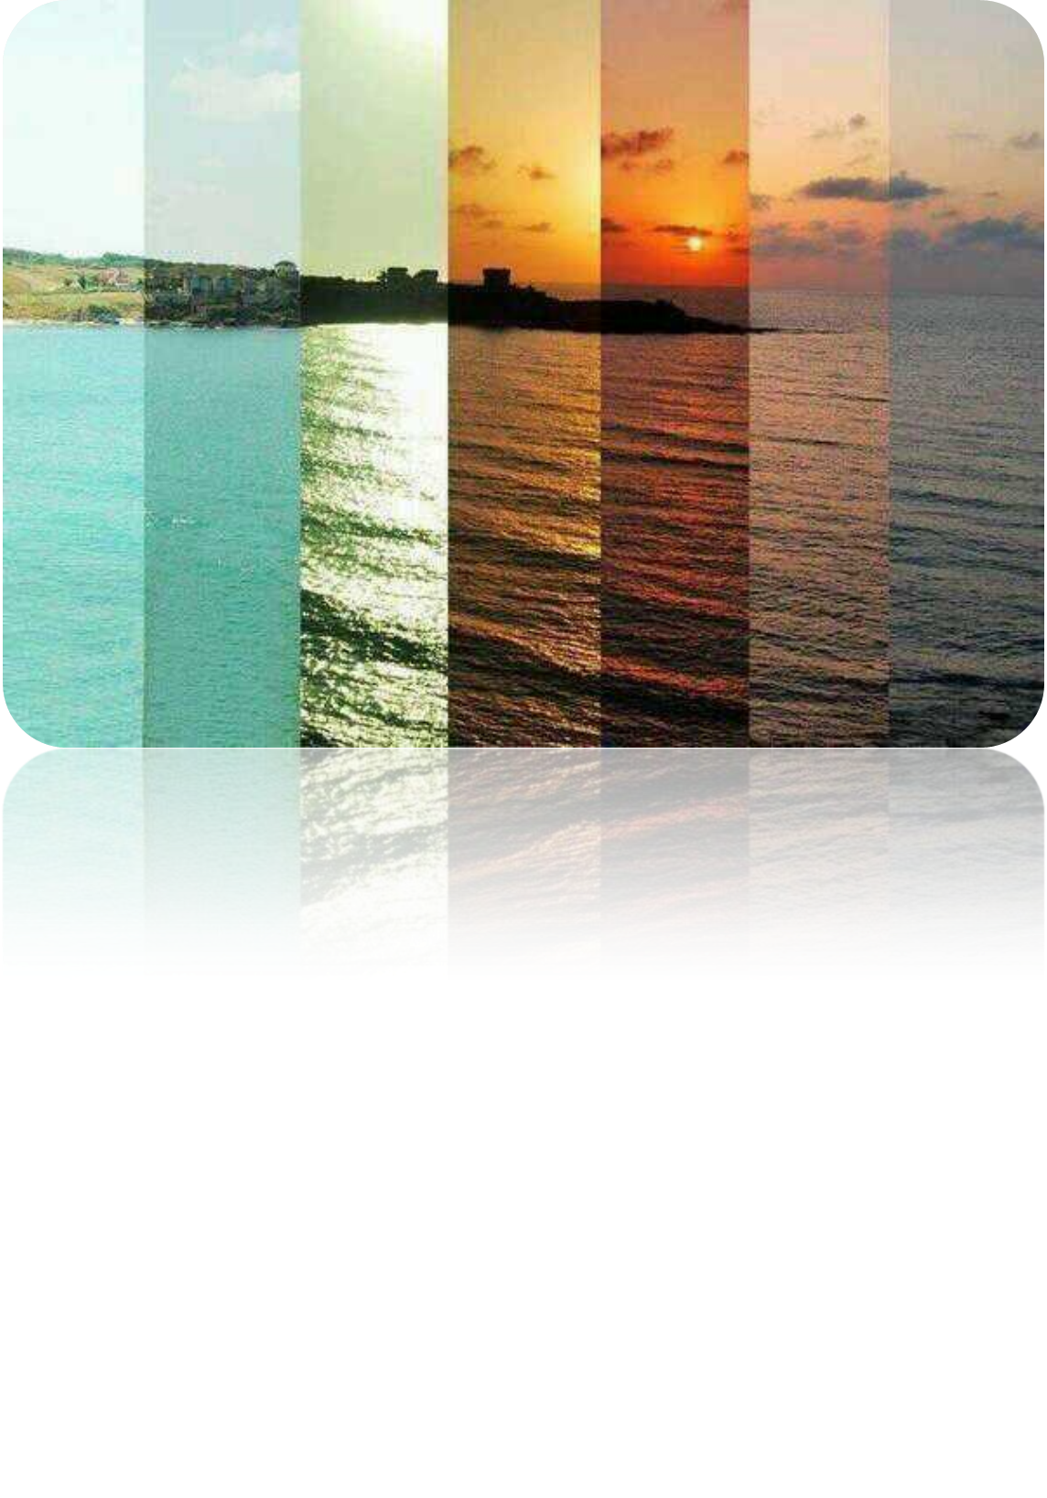
Why Does the Sky Change Colour as the Day Progresses?
Chitra Patil
Mr. McClure
SCH 4U0
18 December 2013

Slide 2

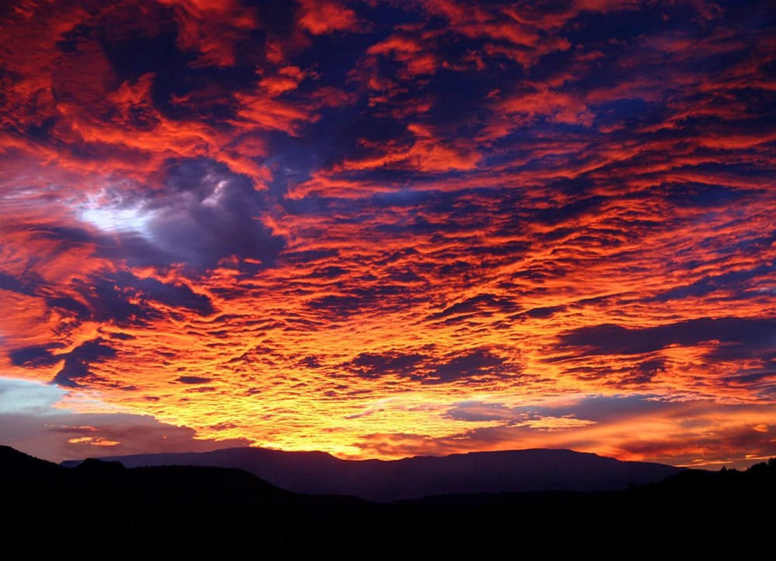
Every colour change in sky is related to light and atmosphere
Colour is what the human eye perceives when light is given off

Slide 3
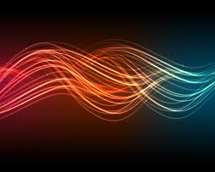
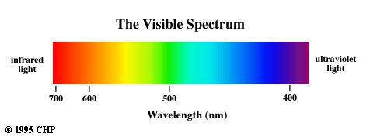
1. Light

Slide 4
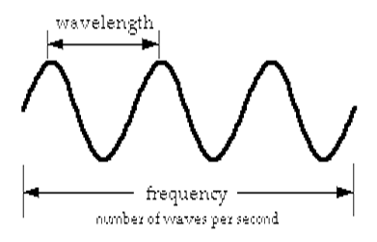
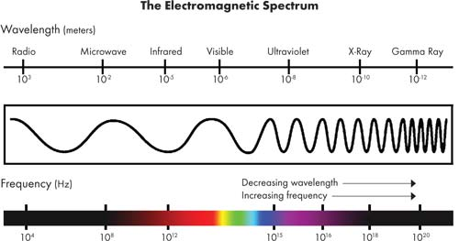
1. Light
Light waves are electromagnetic energies (electromagnetic spectrum!)
They have different waves and frequencies
  Long wavelength = low frequency + energy
Travels at 299,792 km/sec (speed of light)

Slide 5
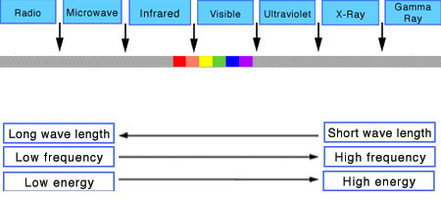
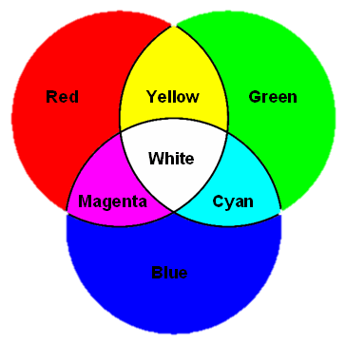
1. Light (cont’d)
Visible light looks white:
  White is made up of different colours (monochromatic light)
  Each colour is related to size of wavelength, frequency, and energy
Sun’s colours are arranged from short to long
  Light with shorter wavelengths (ie: blue) are more easily absorbed in sky
Rayleigh scattering: process of absorbing light and scatter particles

Slide 6
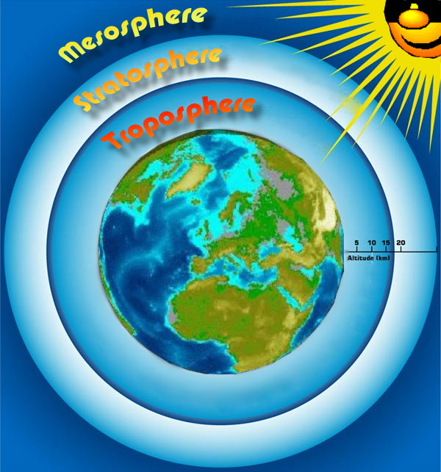
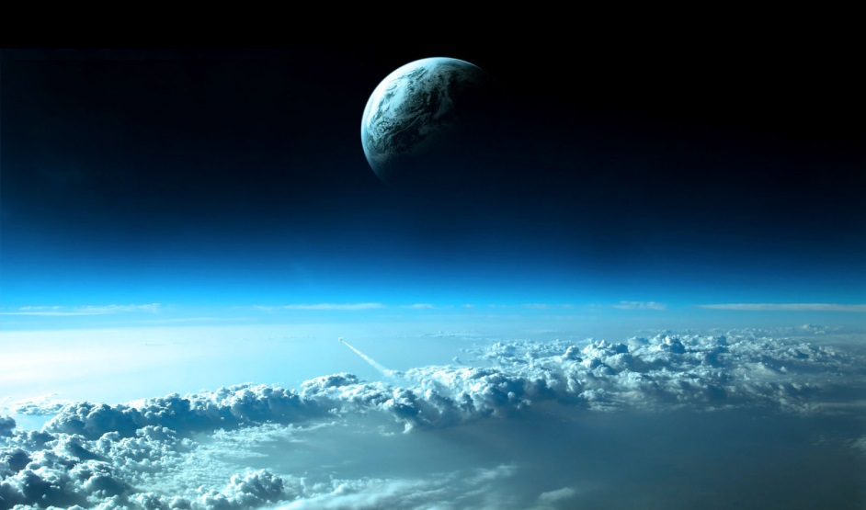
2. Atmosphere

Slide 7
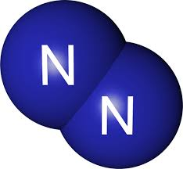
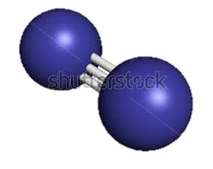
2. Atmosphere
Molecules present:
  Carbon dioxide
  Ozone
  Hydrogen gas
  Nitrogen gas
  Oxygen gas
When light is shone, N₂ gas and O₂ gas will absorb the most energy…
Let’s focus on these

Slide 8
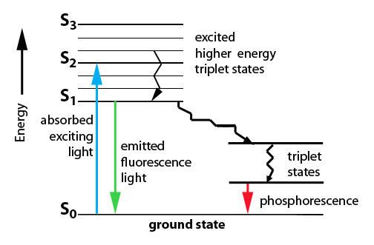
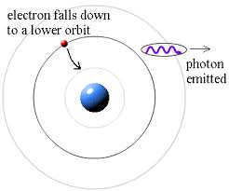
2. Atmosphere (cont’d)
F L U O R E S C E N C E
Called fluorescence
Electrons in N₂ gas and O₂ gas will be excited
Electrons become promoted to higher sublevel
They have a time-frame for which they can stay excited
  Once reached, it may fall down energy sublevels or entire energy levels
  Photon is released

Slide 9
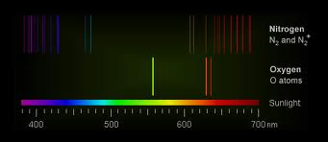
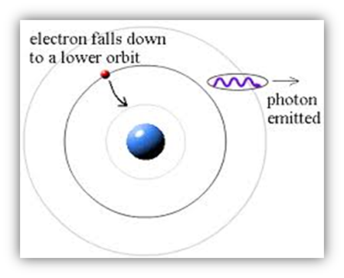
2. Atmosphere – Fluorescence (cont’d)
Oxygen gas and nitrogen gas bright-line emission spectra
This is [half of the reason] why sky is blue!

Slide 10
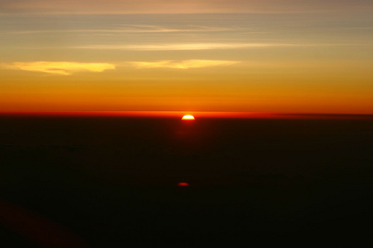
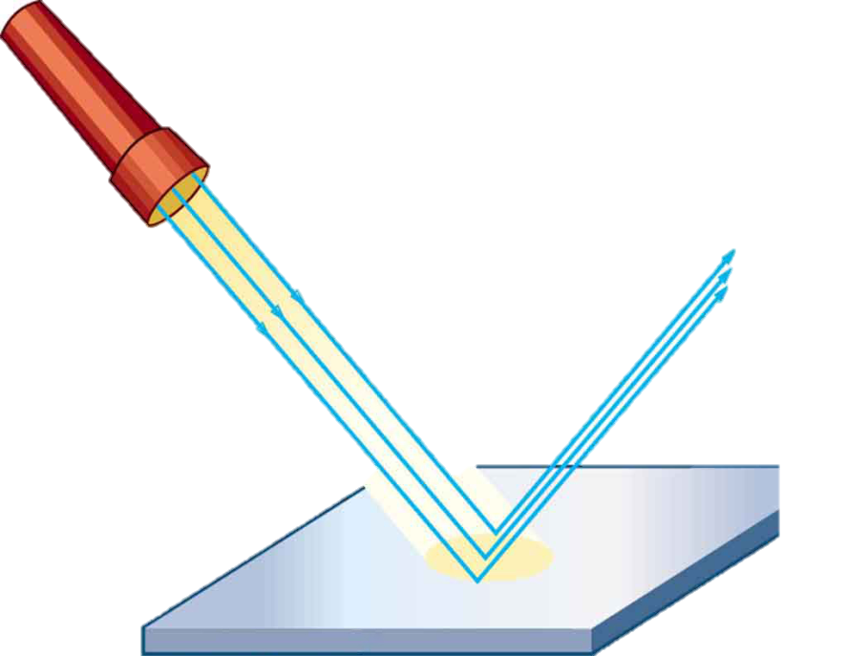
2. Atmosphere (cont’d)
Atmosphere is thicker when it’s closer to the Earth (gravitational pull)
  This is why horizon is another colour
  More atmosphere = more molecules to scatter light
  Thickness determined by weather patterns and human factors
Light travels straight until it hits an atmosphere particle
  ie: when light hits water molecule, water acts as a mirror and reflects light wavelengths

Slide 11


We Must First Understand…
[The other half of] Why sky is blue.

Slide 12
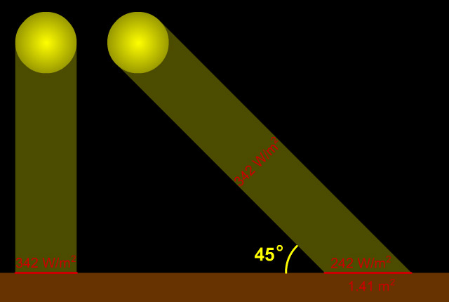



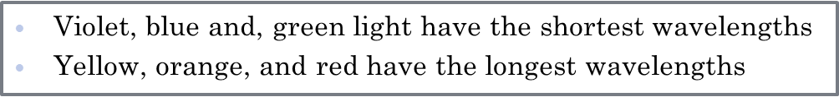
Blue Sky
When Sun is high in the sky, it emits wavelengths at the shortest angle
What colour does the shortest angle allow for…?

Slide 13
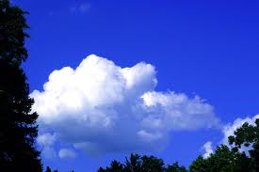
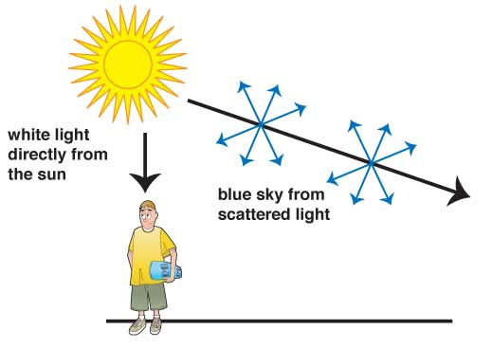
Blue Sky (Part 2)
Blue light is the shortest distance in atmosphere
Atmospheric gases absorb blue and violet colours and cause them to scatter (more than any other colour)
  Rayleigh scattering
  Human eyes do not register violet well
  …and so humans see blue!

Slide 14
2. Atmosphere – Video
http://www.discovery.ca/things/default.htm?clipid=510962
[0:56 – 1:34 min]

Slide 15
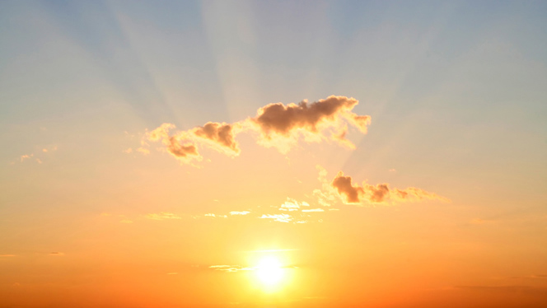
Blue never goes away… we just cannot see it sometimes!

Slide 16
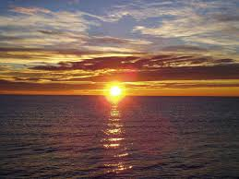
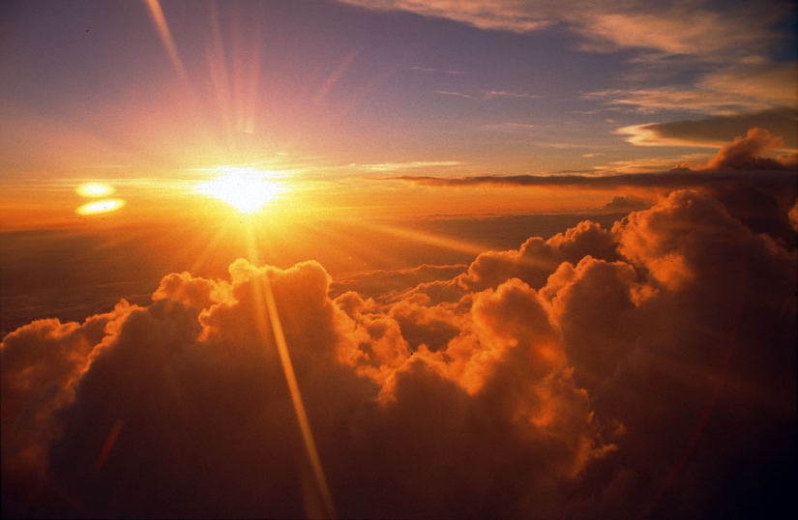
And finally…
Sunrise and Sunset

Slide 17
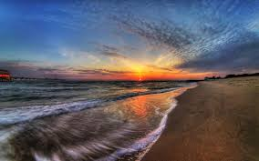


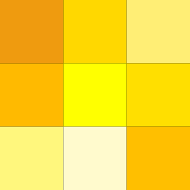
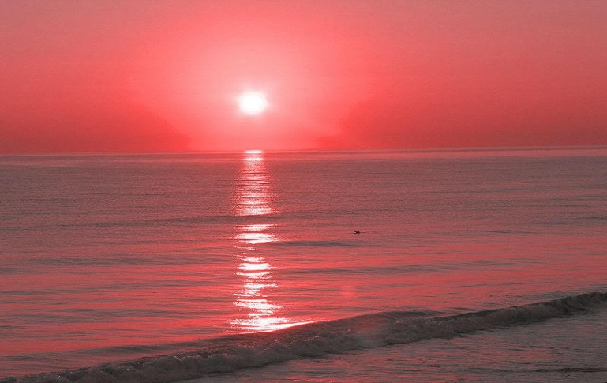
Sunrise
When Sun reaches Earth, there is a longer angle
What colours does the longest angle allow for…?
As Sun gets higher in sky, these colours fade and blue light becomes more scattered
  Blue sky returns

Slide 18
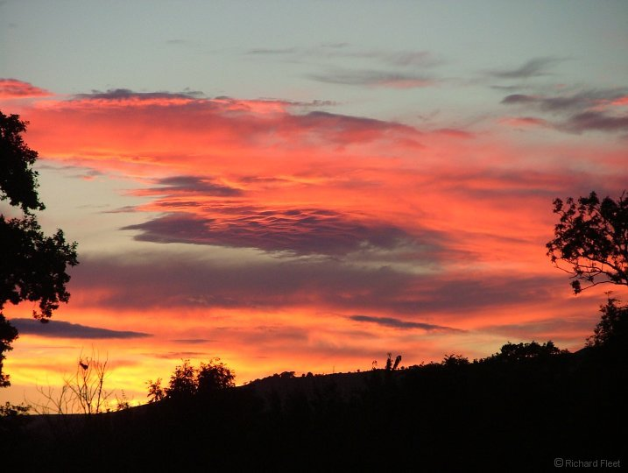
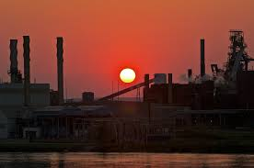
Sunset
Reverse sunrise… but a bolder display
Dust/debris is being kicked around during the day
  This filters light
  Polluted cities have the most beautiful sunsets

Slide 19
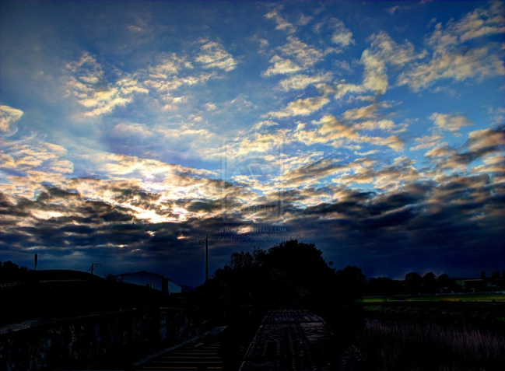
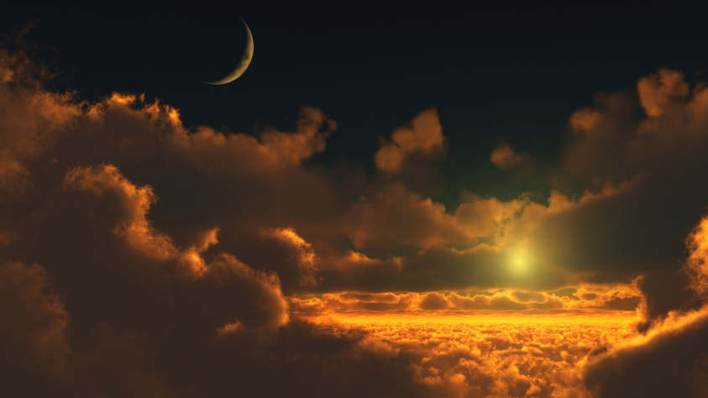
How are the Details Determined?

Slide 20
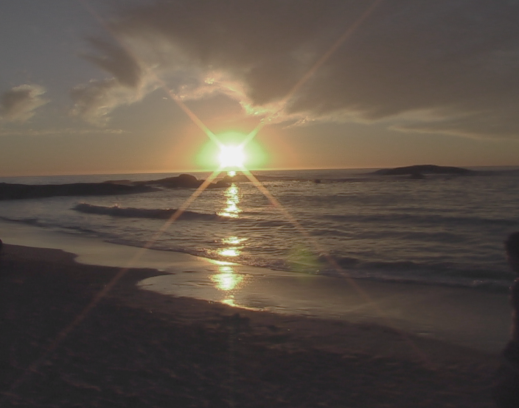
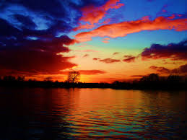
Details
  Dust
  Pollution
  Smog
  Clouds
  Water vapour or humidity causes the sky to appear gray because it deflects light

Slide 21
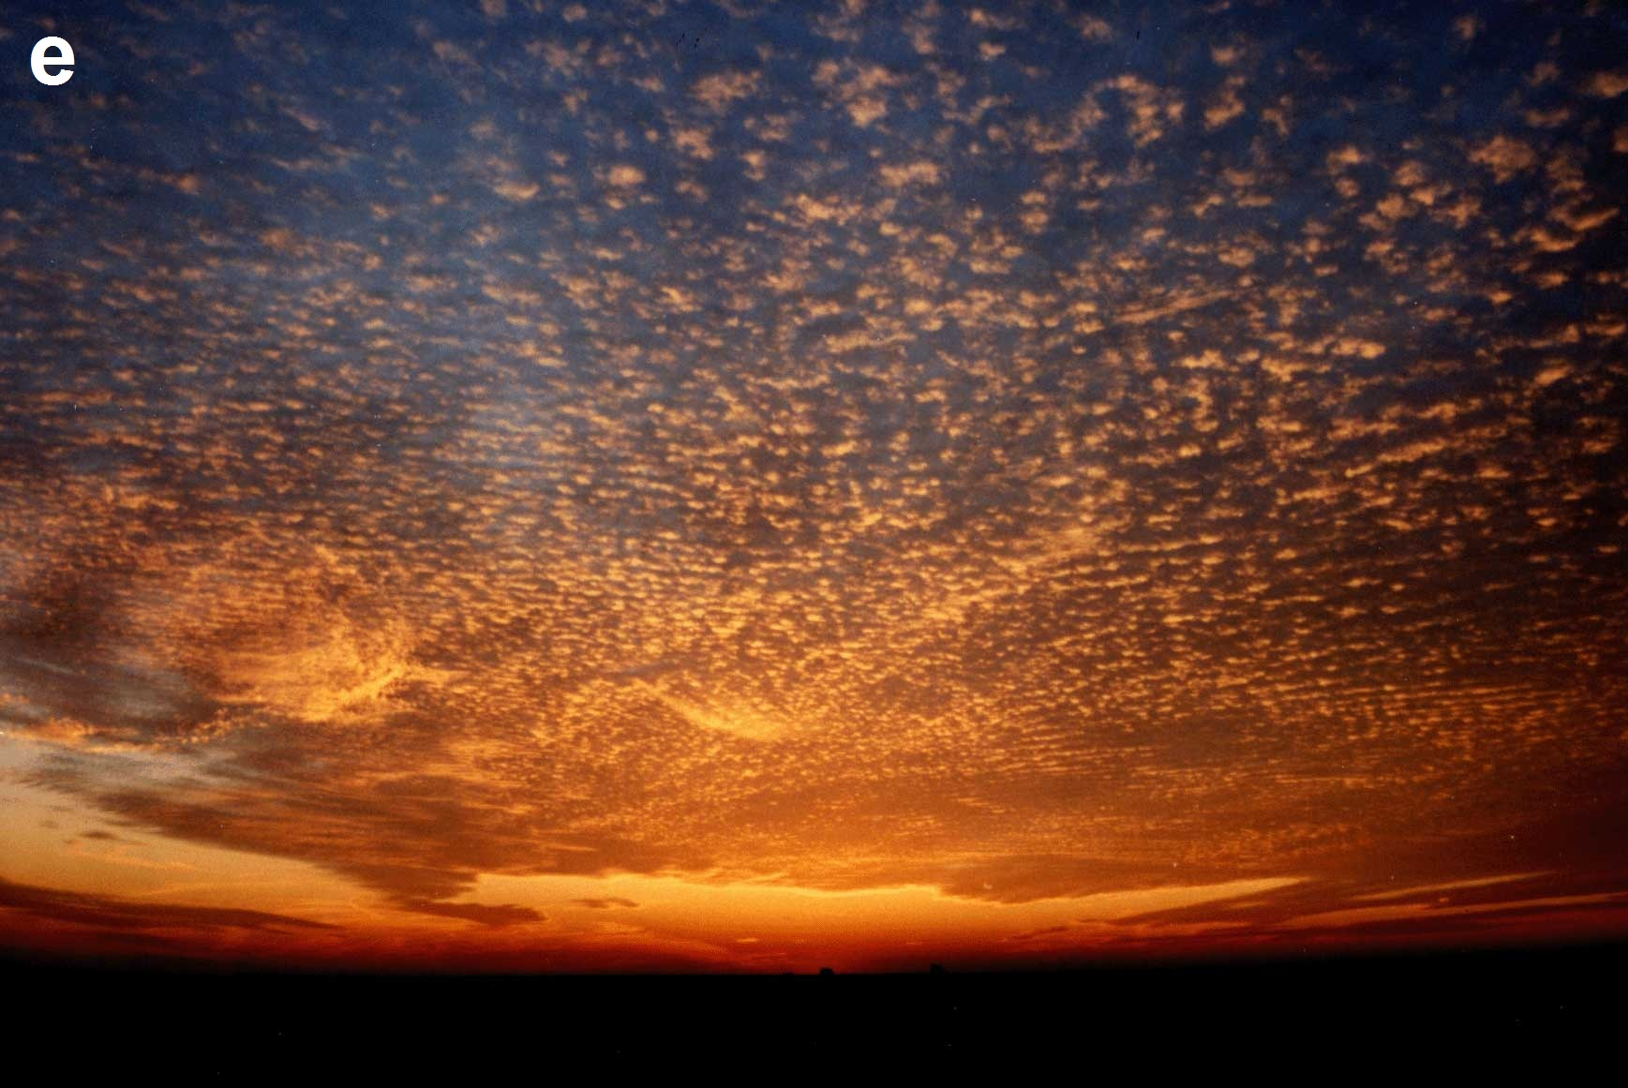
The End!

Slide 22
Works Cited
Adams, Julia. "What Makes the Sky Change Colours?" Colours. N.p., n.d. Web. 8 Dec. 2013.
<http://www.sewanee.edu/chem/Chem&A
"Color." The Physics Hypertextbook. N.p., n.d. Web. 9 Dec. 2013. <http://physics.info/color/>.
Corfidi, Stephen F.. "The Colors of Sunset and Twilight." THE COLORS OF TWILIGHT AND SUNSET. N.p., n.d. Web. 18 Dec.
2013. <http://www.spc.noaa.gov/publications/corfidi/sunset/
Gibbs, Philip. "Why is the sky blue?" Why is the sky Blue? N.p., n.d. Web. 13 Dec. 2013.
<http://math.ucr.edu/home/baez/physics/General/BlueSky/blue_sky.html
"Telescopes From the Ground Up.“ Science Background. N.p., n.d. Web. 8 Dec. 2013.
<http://amazing-space.stsci.edu/resources/explorations/groundup/teacher/sciencebackground.html
"Things You Need To Know." Discovery Channel Canada. N.p., n.d. Web. 15 Dec. 2013.
<http://www.discovery.ca/things/default.htm?clipid=510962>.
Zozra, Richard. "Preliminary Thoughts on Blue Sky Technology Given Access and Decision Systems ." The Blue Sky Access and
Legal Aid System. N.p., n.d. Web. 12 Dec. 2013. <http://jolt.law.harvard.edu/symposium/articles/Zorza-
BlueSkyTechnology.pdf>.

