Slide 1
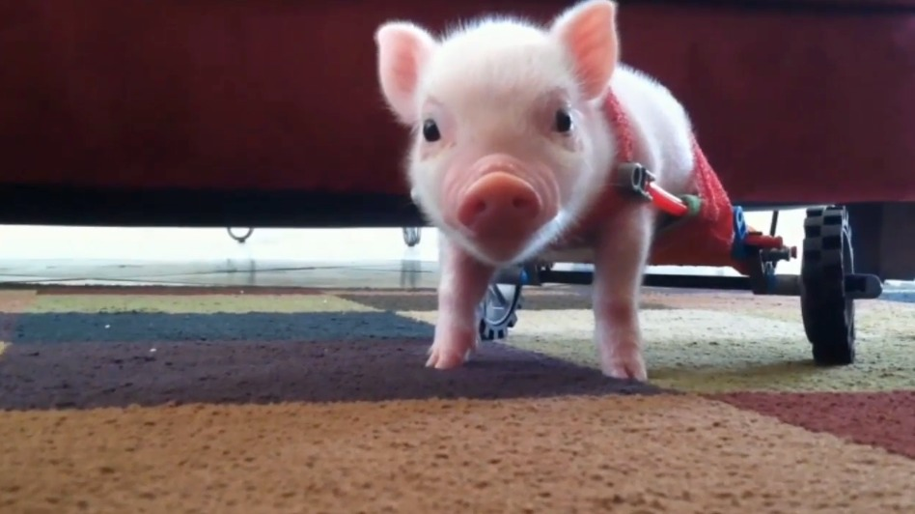
Animal Science
Animal Reproduction
Meet Chris P Bacon
Chris P Bacon with cat

Slide 2
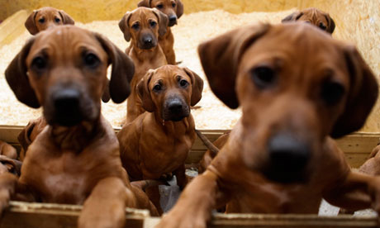
Reproduction
DEFINITION:
The natural process among organisms by which new
individuals are generated and the species perpetuated.

Slide 3
Key Terms So far…
Conception
Gestation
Parturition
Colostrum

Slide 4
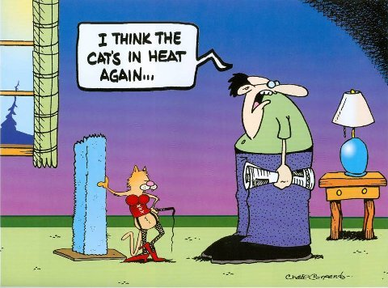
Estrus (Estrous)
DEFINITION:
The periodic state in which most female mammals (excluding humans) are approaching ovulation and most receptive to mating. Also known as “heat”.

Slide 5
Different species Cycles
Estrous cycle- reoccurs as long as the animal is not pregnant
Categorized by the frequency of occurrence throughout the year
  Polyestrous (poly=many)
  Seasonally polyestrous
  Monoestrous (mono=one)
  Diestrous (di=two)

Slide 6
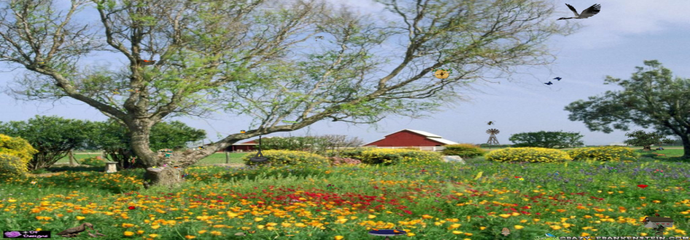
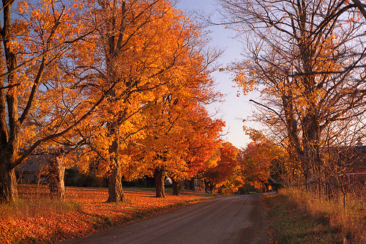
Different species Cycles
  Seasonally Polyestrus- cycles occur only at certain times of the year
    Horses-Long-day breeders- go into estrus as days get longer
    Sheep-Short-day breeders- go into estrus as days get shorter

Slide 7
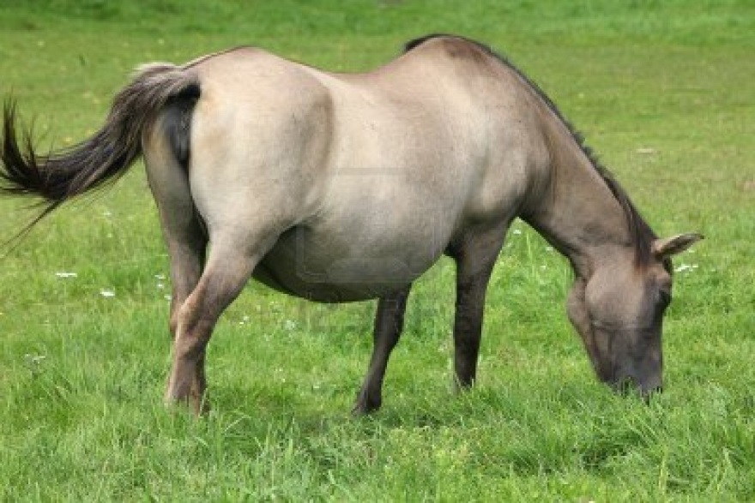
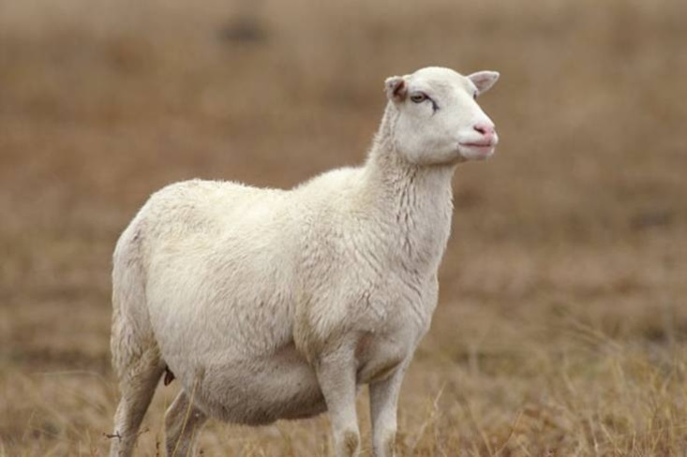
Different species Cycles
Horse gestation- 340 days (11 months)
  Breeds in the Spring
    Why?
Sheep gestation- 145 days (5 months)
  Breeds in the Fall
    Why?

Slide 8
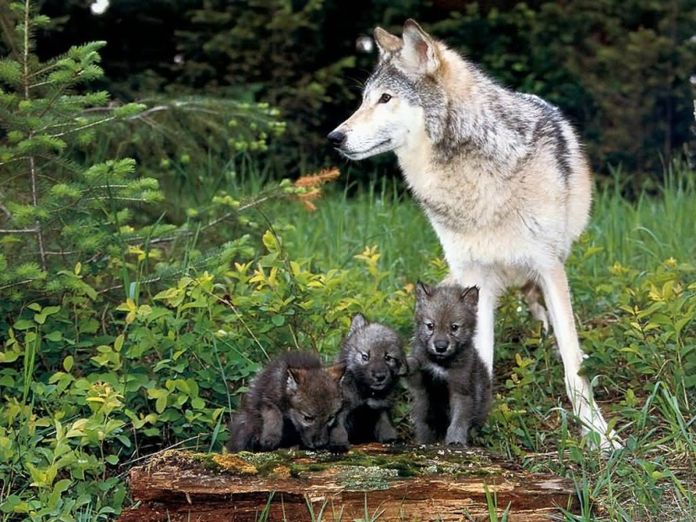
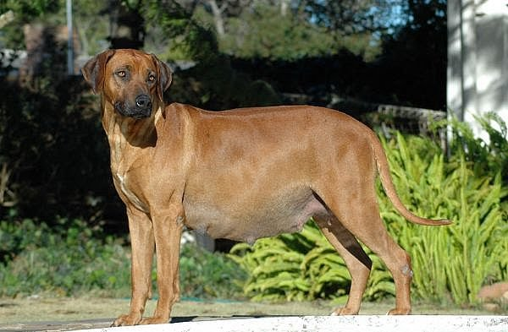
Different species Cycles
Monoestrus/Diestrus- go into heat only once or twice per year
  Wolves are monoestrus
  Dogs are diestrus or sometimes more (domestication)

Slide 9
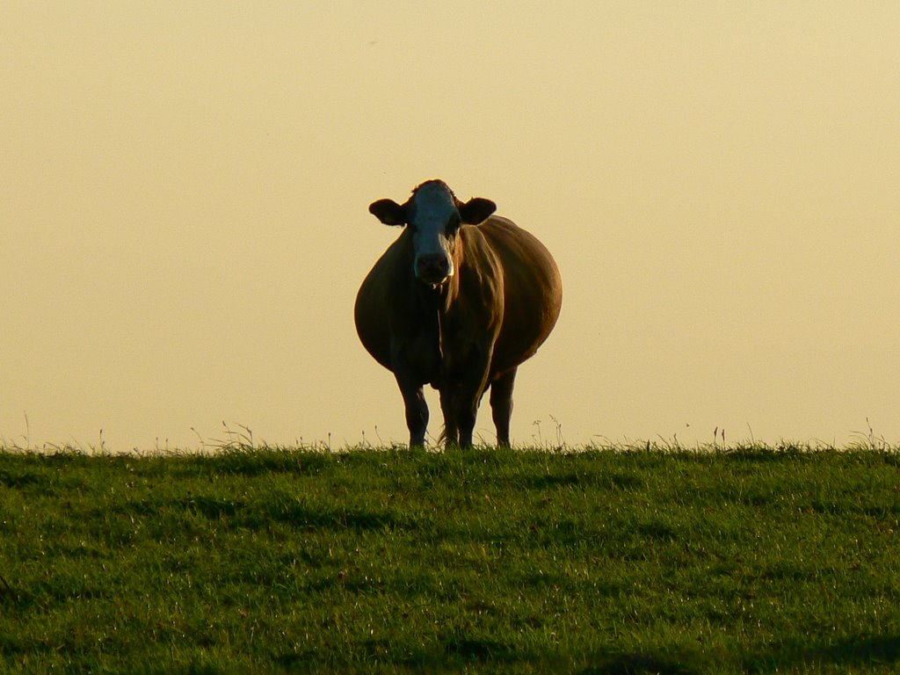
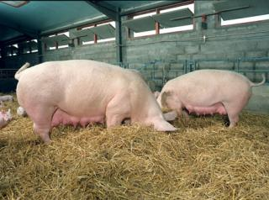
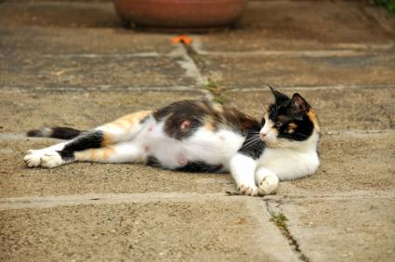
Different species Cycles
    Polyestrus- go into heat many times per year
      Cats, Cows and Pigs

Slide 10

Controlling Reproduction
    Cows
      Why is it reproduction extremely important with dairy cows?
No Baby = No Milk = No Money

Slide 11
Controlling Reproduction
    Cows
      Different ways to detect heat
        Watching animals
        Painting tails
        Heat detector aids
        Pedometers
        Just let a bull do it

Slide 12
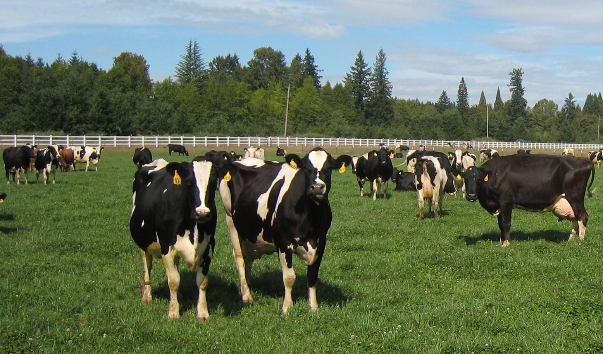
Ways to detect heat
        Watching animals, paint, color change strips
          Heat detection

Slide 13
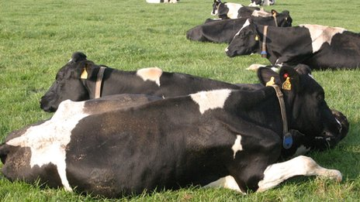
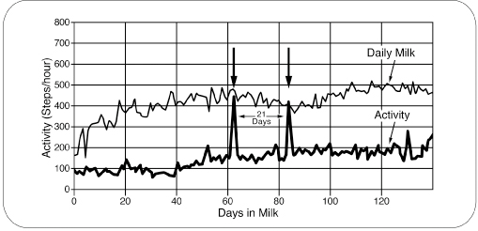
Ways to detect heat
        Pedometers- ‘foot’-meters
          Necklaces measure steps per hour…more activity usually means estrus
          Transmits to a computer graphs data

Slide 14
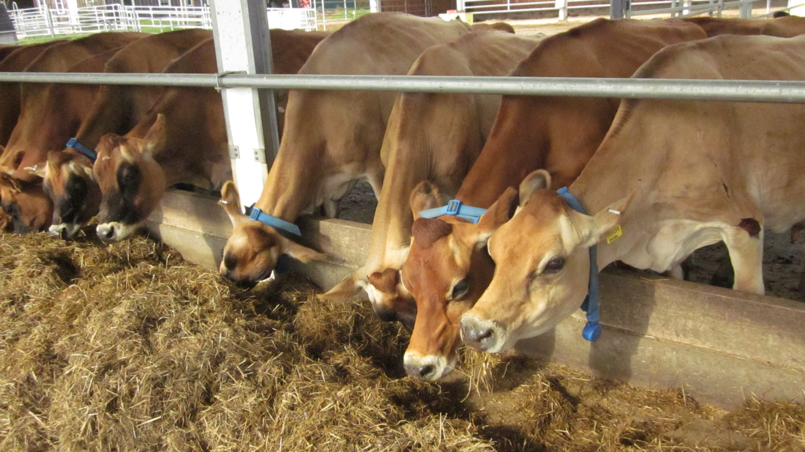
Ways to detect heat
        Pedometers at UNH Organic Dairy

Slide 15
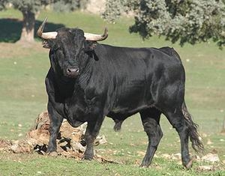
Ways to detect heat
      Let the bull do it. He can smell exactly when the cow is ready but…
      Would you want to be in the field with this guy?

Slide 16
Controlling Reproduction
      Which method would you use?
        Groups are farms. Each uses a different method.
          What are the pros and cons of each method?
          Would you use this method? Why or why not?
          Which method would you prefer? Why?

Slide 17
Controlling Reproduction
            Cost-
              Watching-$48/day
              Paint- $.50 each application per cow
              Color Break Strips- $1.55 each
              Pedometer set-up-$40-$100 per cow
              Bull-cheaper than 1 cow
        How much management is needed?
        How good does it work? (Efficacy)
Method | How does it work? | Pros | Cons | Rank

Slide 18
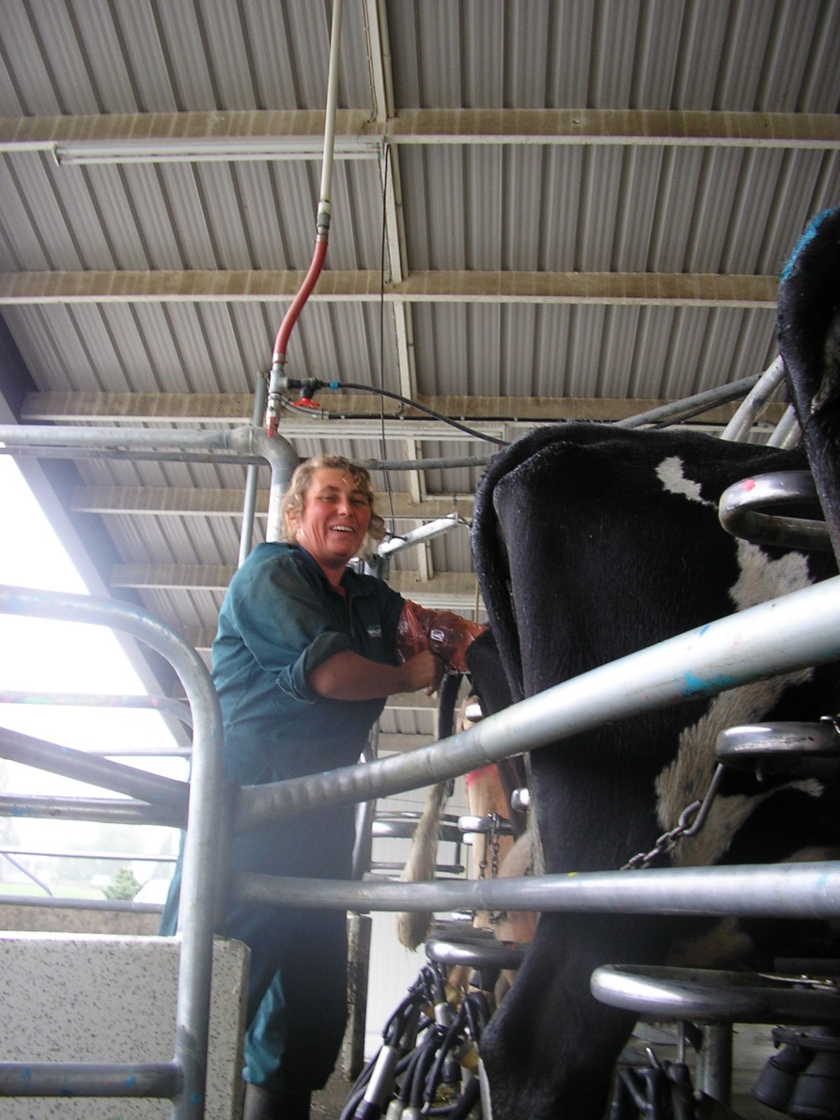
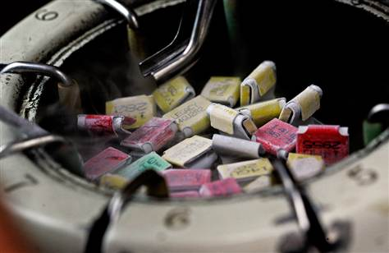
Controlling Reproduction
    You’ve detected estrus. Now comes the fun part.

Slide 19
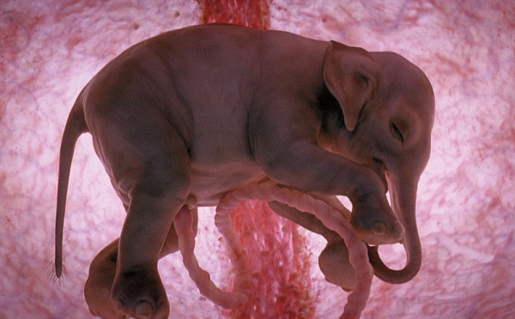
Placental Animals
    We know how placental mammals work, right?

Slide 20
Non- Placental Animals
    Reptiles
    Birds
    Fish
    Marsupials
    Monotremes

Slide 21
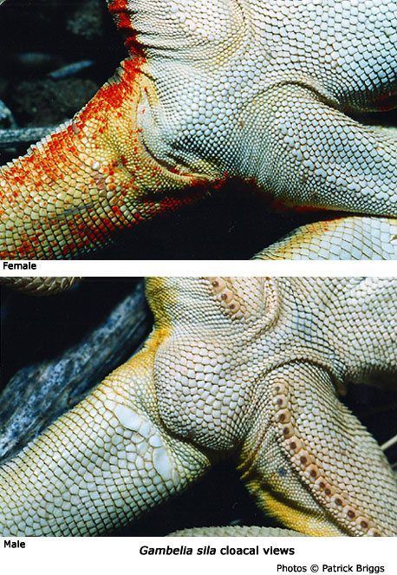
Reptiles
        Have a CLOACA.
          a common orifice where feces, urine, and reproductive functions occur
          The male fertilizes the eggs inside the female and she lays them to hatch.
          The yolk inside the egg provides nutrients like a placenta.

Slide 22
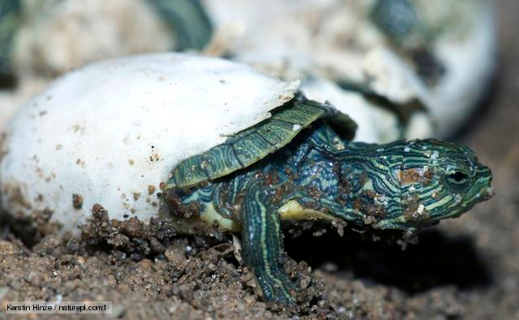
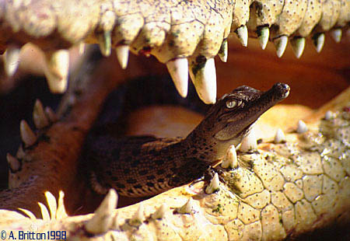
Reptiles
      Young are independent upon hatching. No parental care.
        Except Crocodiles

Slide 23
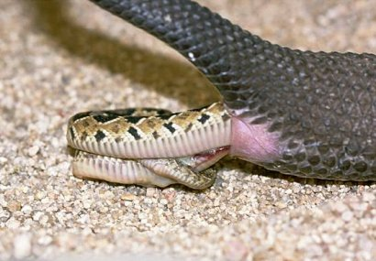
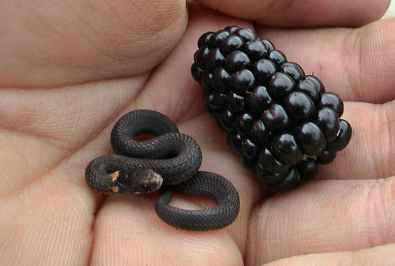
Reptiles
      Some reptiles keep the eggs inside and give birth to live babies.
      Some snakes and lizards do this but they still don’t care for the young.

Slide 24
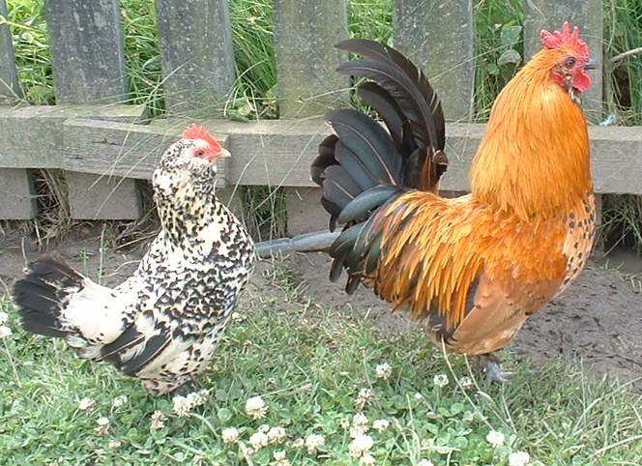
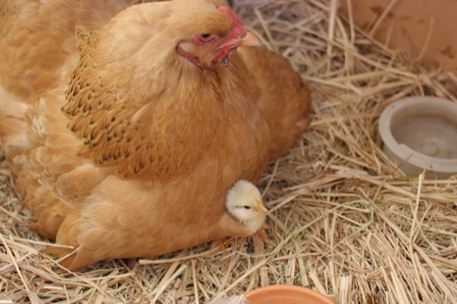
Birds
      Birds have a CLOACA too!
        But they take care of the eggs and the chicks (some exceptions)

Slide 25
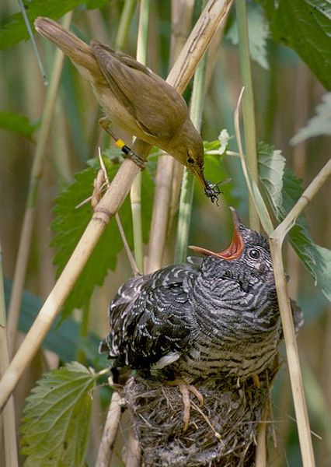
Birds
      Brood Parasites- female bird lays her eggs in the nest of another species so she doesn’t have to take care of it.
A Reed Warbler feeds a baby Cuckoo.

Slide 26
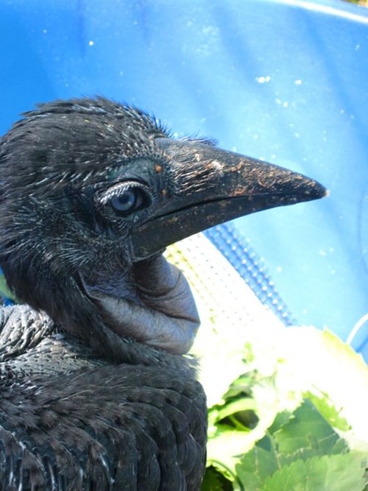
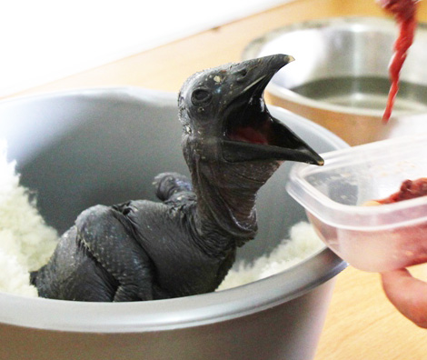
Birds
      Do you think birds evolved from reptiles? Why?
      Endangered Ground Hornbill Chick

Slide 27
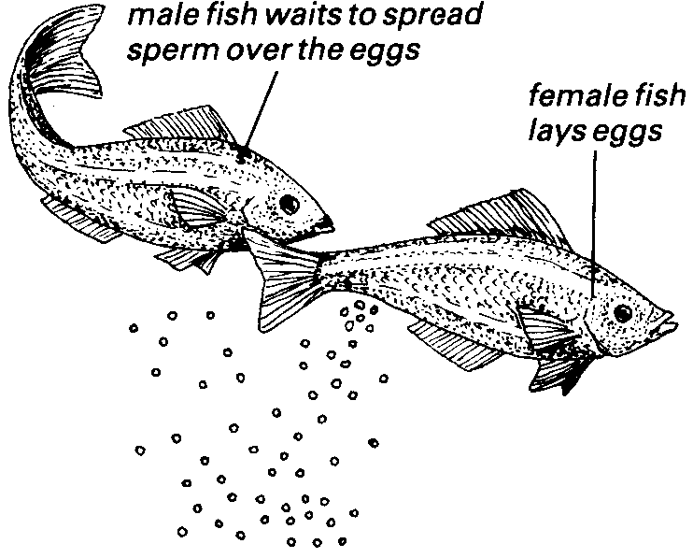
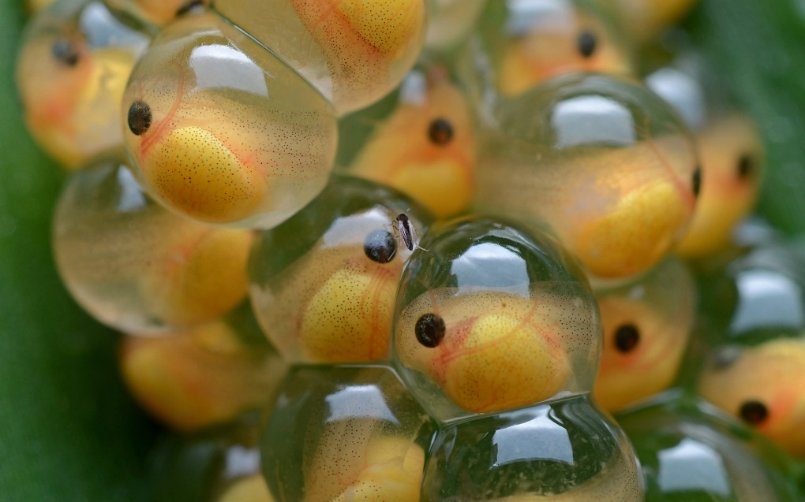
Fish
A female fish lays eggs then the male comes by and fertilizes them. This is called SPAWNING. They have a yolk sac like birds and reptiles and no parenting…unlike Nemo.

Slide 28
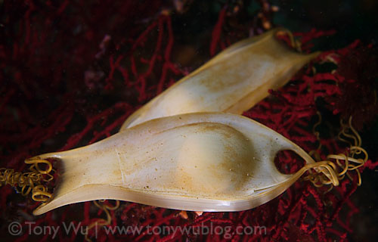
Sharks
Sharks don’t spawn like other fish. They reproduce sexually like other animals. Then they take one of three options.
Lay eggs in the water like other fish.
When found on shore, these are called Mermaid’s Purse or Devil’s Purse
Small-spotted Catshark egg case

Slide 29
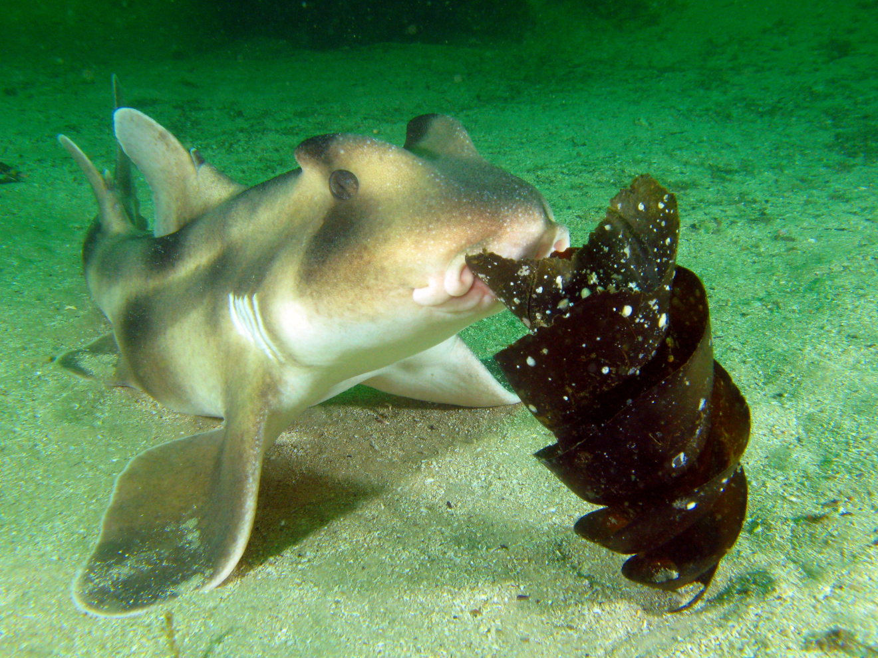
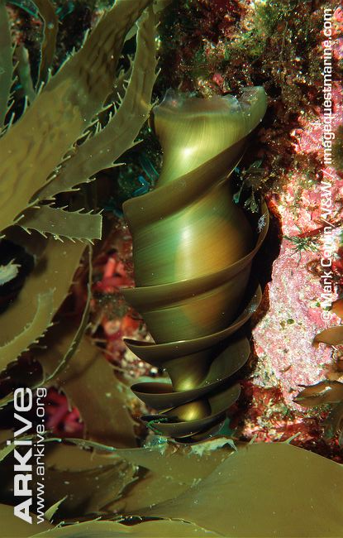
Sharks
Crested bullhead shark

Slide 30
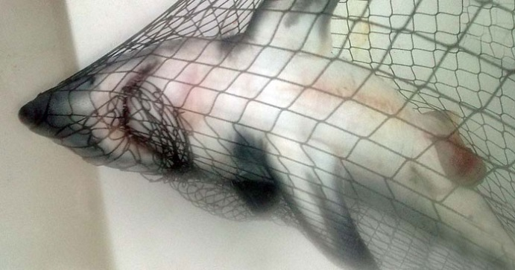
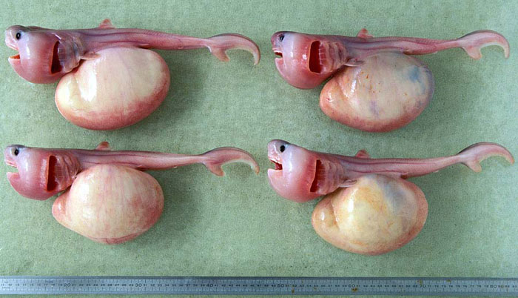
Sharks
  Or they can then…
Eggs hatch inside the mother and chill out, eating from their yolk until they are born.
  These were found inside a Porbeagle shark…yolk, no shell.

Slide 31
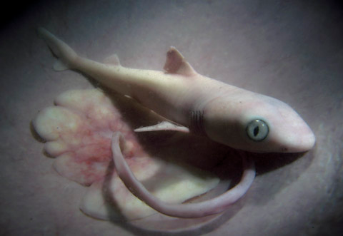
Sharks
  Or they can then…
Their yolk attaches to the mom’s uterus and becomes a placenta…taking nutrients from the mom until they are born,

Slide 32
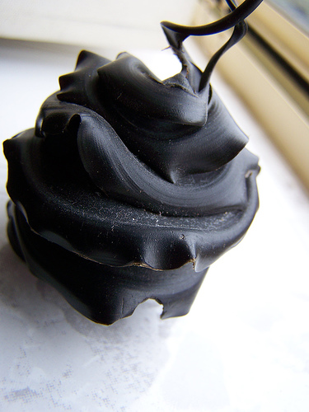
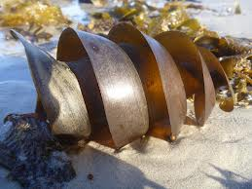
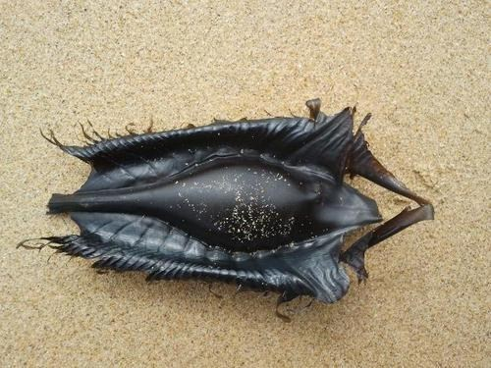
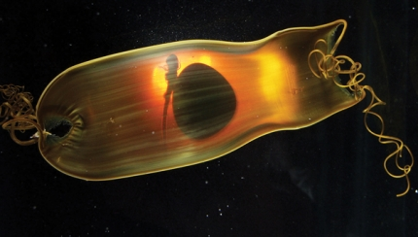
Sharks are definitely swag!

